Slide 1
Arun Icecream
Done by:
MD.Yogashree

Slide 2
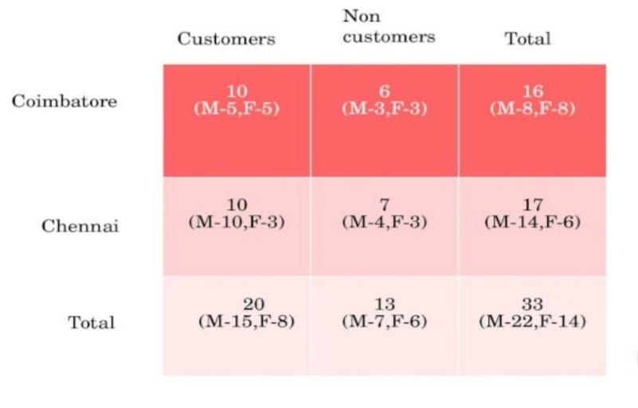
Customers & Non Customers

Slide 3
Customers preferable shapes

Slide 4
People’s review

Slide 5
Target Audience
There is no particular pattern, but among children chocolate and butterscoth flavour is most preferable.
People >= 40 years of age reduce their consumption of icecreams
Arun icecream advertisements are the mostly popular ads literally know by everyone and introduces healthy ice creams
It also accepts both in take and take away process.
Arun icecream is mostly prefered by family rather than youth generation.

Slide 6
Hypothesis Test
Y=Purchase Count; X=No. of Districts
Alpha=0.05
Chi square test
H0->P(A)=P(B);
H1->P(A)!=P(B)
Code
P value

Slide 7
Table Comparison(sample)
Districts | Purchase Count
Trichy | 2500
Kanyakumari | 1800
Coimbatore | 1965
Madurai | 2000
Karur | 2160
Thanjavur | 1950
Nilgiris | 1550
Vellore | 2550

Slide 8
Hpothesis Interpretation
P value is less than alpha based on the hypothesis test
And it is null set
Therefore, districts doesn’t affect the purchase count

Slide 9
Thank You

